Slide 1
Mortgage Insurance Factor Proposal Analytics Summary
July 2016

Slide 2
Agenda
Overview
Prior Approach Description
High-level of Proposed Approach
Estimation Process for Proposal Evaluation
Actual vs. Expected Fit based on Proposal Framework
Deep Dive on Proposal Components:
a. Interest Caps
b. Allowable Delays & Impact on Self-Curtailment
c. Foreclosure Cost Factors
d. Costs Included/Excluded (Self-Disallowances)
Example Application of Proposal to a Single Claim
Follow up materials to be delivered

Slide 3
Overview
Fannie Mae is actively seeking areas of our business model where we can find simpler and more certain approaches than historically used.
Mortgage Insurance (MI) claims processing is one area of focus where we have identified a large number of manual processing points and long timelines involved in collecting fully and finally the MI proceeds.
The main items that frustrate servicers and cause all companies involved (Fannie Mae, servicers, and MI’s) during the claims filing process are short-pays for various reasons.
‘Disallowances’: Costs claimed on the explanation of benefits (‘EOB’) are commonly disallowed due to differences with MI company policy around claimability.
‘Curtailments’: Variable costs and delinquent interest that is excluded from the MI claim calculation due largely to lengthy foreclosure timelines.
After EOB payment, Fannie Mae would look to servicers for indemnification on many of these items, causing potentially protracted processing delays.
The vast majority of claims paid in recent years (70%+) had at least one of these items present.

Slide 4
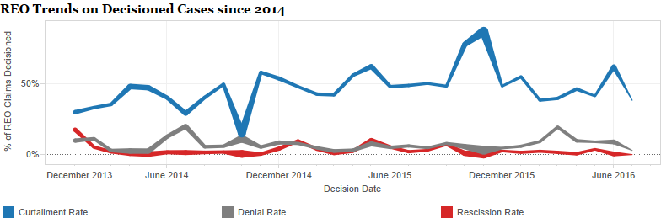
Overview, con’t
Fannie Mae is proposing that Fannie and MI companies enter into a partnership on a new structure for streamlining the MI claim and payment process.
As part of this proposal, Fannie Mae has incorporated considerations commonly associated with curtailments and disallowed costs.
The proposal would not control for underlying reasons that typically are associated with denials or rescissions of claims.
This would have streamlined the processing for curtailments on about 50% of MI claims paid in the first half of 2016 for Fannie Mae REO alone.

Slide 5
Prior Approach Description
Prior attempt at streamlining: In the early 2000’s, we had proposed a factor approach for claims.
The prior streamline factor approach used a single factor to account for interest and certain costs, per state.
The only loan-level piece of information used was the UPB, which the factor was multiplied against to arrive at the claim amount.
For example:
UPB = $100,000
Streamline Factor = 116%
Final Claim Amount = $116,000
This approach suffered from its over-simplistic design as the housing crisis entered a protracted state and foreclosure timelines grew much longer than anyone anticipated.

Slide 6
Prior Approach Issues
Lack of granularity of the streamline factor versus the reality of claims – no differentiation for timelines or other important characteristics within a state.
Assumed either homogeneity in claimable costs or no changes in distribution of defaults by any important characteristics from prior years.
Changes in foreclosure trends, timelines, types, and processes were rapid.
Composition of loans moving to claim were atypical of defaults prior to crisis.
Additionally, the factor was constructed with an REO outcome in mind, but other alternatives became common in 2008 and later in response to increasing defaults.
Extreme foreclosure timelines vs. history and conflicts with MI company servicing guides.
As a result, most MI companies opted out of the streamlined factor approach and reverted to manual processing.

Slide 7
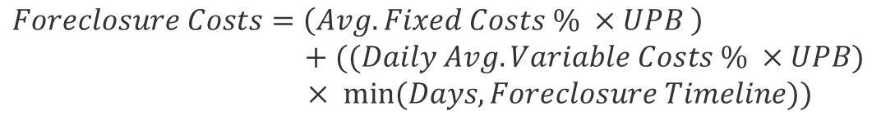
High Level of Proposed Approach Claim Amount Components
In typical claim processing, the MI claim amount is calculated as the sum of the UPB, interest, and the foreclosure costs for any given loan default, with overlays for specific guide thresholds on costs and interest periods.
The changes that are recommended to the MI claim amount are outlined below:
$$MI Claim Amount=UPB+Interest+Foreclosure Costs$$
Actual UPB at Default
Actual Interest
or
Interest Capped at Allowable Foreclosure Timelines
The MI Factor Algorithm Estimate solves for Foreclosure Costs
$$Foreclosure Costs=\left(Avg. Fixed Costs \% ×UPB \right)$$
$+ ((Daily Avg. Variable Costs \% ×UPB)$
$× min⁡(Days,Foreclosure Timeline))$

Slide 8
Estimation Process for Proposal Evaluation
To construct the proof of concept and provide for a “back-test” of the framework, we derived the factors and then applied them to a later period. In both the estimated population and the testing population, claims were filed and decisioned.
Estimation population: Third Party Sale (TPS) or Short-Sales that liquidated between July 2013 and June 2014 or REO property dispositions during that same period.
This included loans with or without MI coverage.
The testing population were cases that met the same criteria but with event dates between Jan-2015 and Dec-2015.
We chose to split the cost components into fixed and variable, with the variable cost factor being derived as a per diem.
While we tested numerous frameworks, we settled on an approach for the cost factor derivations that controlled for geographic location, disposition channel, property value proxies, and the type of property (e.g., condo vs. single-family).

Slide 9
Actual vs. Expected Fit based on Proposal Framework
Four dimensions governed our model selection:
Goodness of Fit: How well do we explain variation in overall benefit payments?
Precision of Estimates: How close to the actual amounts were our predicted amounts?
Ease of Implementation: Balance on over-specification – principle of parsimony.
Longevity & Ease of Updates: How much manual judgement was used in the analytical framework?
The recommend algorithm design strikes the best balance between each of the four performance metrics.

Slide 10
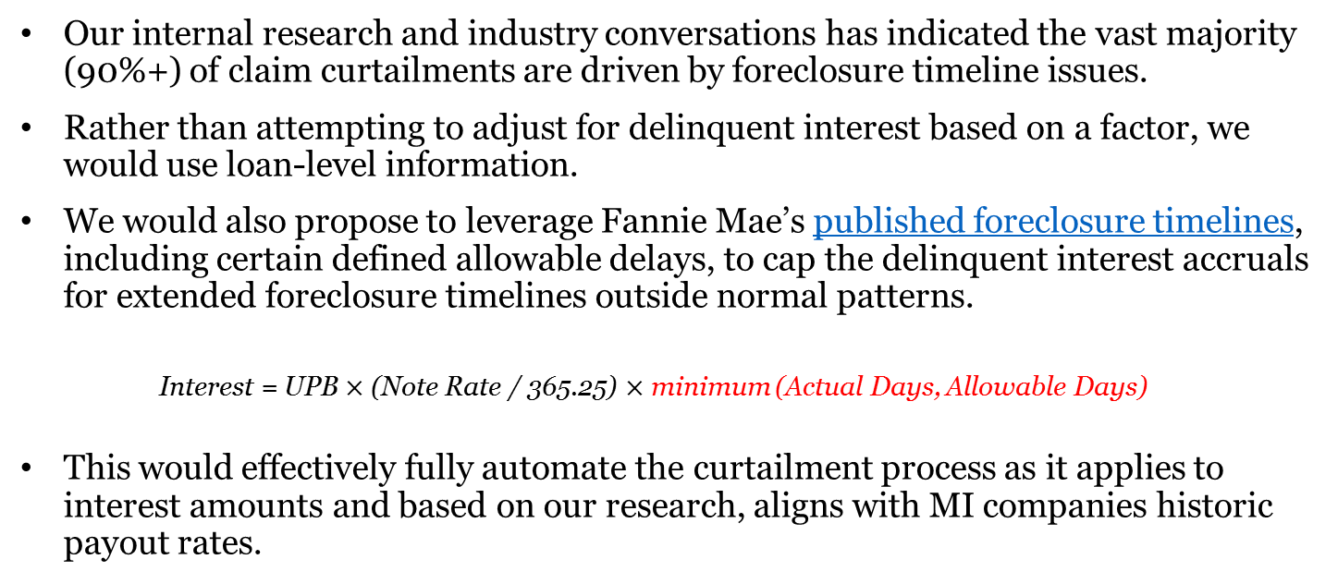
Deep Dive on Components: Adjusting Interest Amounts
Our internal research and industry conversations has indicated the vast majority (90%+) of claim curtailments are driven by foreclosure timeline issues.
Rather than attempting to adjust for delinquent interest based on a factor, we would use loan-level information.
We would also propose to leverage Fannie Mae’s published foreclosure timelines, including certain defined allowable delays, to cap the delinquent interest accruals for extended foreclosure timelines outside normal patterns.
Interest = UPB $×$ (Note Rate / 365.25) $×$ minimum (Actual Days, Allowable Days)
This would effectively fully automate the curtailment process as it applies to interest amounts and based on our research, aligns with MI companies historic payout rates.

Slide 11
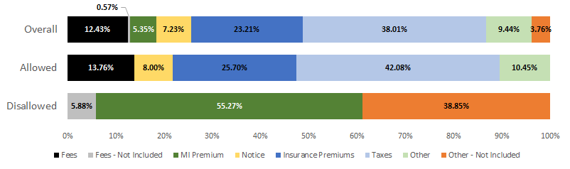
Deep Dive on Components: Self-Disallowance & Costs
At present, different MI companies use their own internal policies to determine allowable and disallowable foreclosure costs.
In order to apply an algorithmic approach to disallowances, a standardized list of allowed and disallowed costs would be necessary.
Any expense that is deemed as a disallowed cost would be excluded from the calculation of the foreclosure costs for factor computation.
Pre-foreclosure Action Cost Compositions for 2013-2015 All Liquidations, by Analysis Treatment

Slide 12
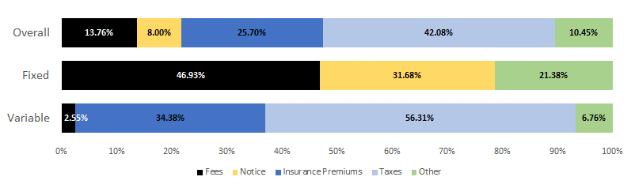
Deep Dive on Components: Foreclosure Cost Factors
The proposal for standardizing foreclosure costs is to leverage a gross up factor, or MI Factor, to estimate average fixed and variable costs by key loan characteristics.
These estimated costs would replace the actual foreclosure costs in the MI claim amount calculation.
We grouped certain costs into Fixed and Variable categories:
Pre-foreclosure Action Allowed Cost Compositions for 2013-2015 All Liquidations, by Analysis Treatment

Slide 13
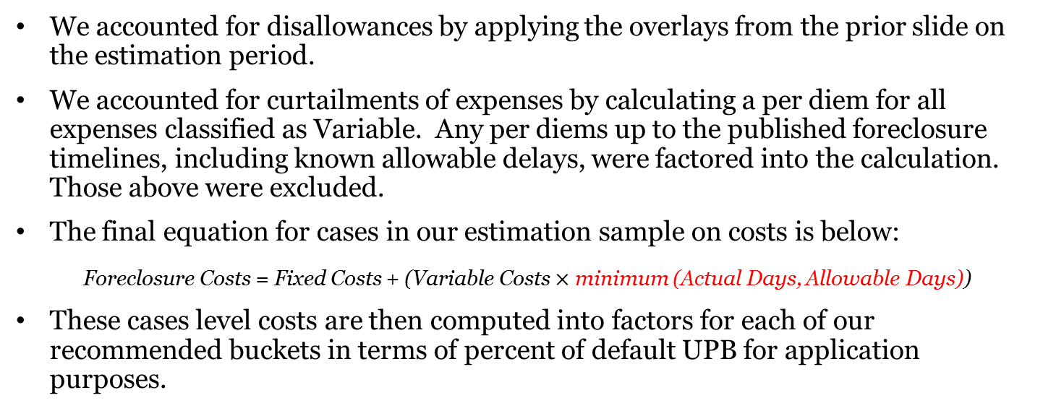
Deep Dive on Components: Foreclosure Cost Factors
We accounted for disallowances by applying the overlays from the prior slide on the estimation period.
We accounted for curtailments of expenses by calculating a per diem for all expenses classified as Variable. Any per diems up to the published foreclosure timelines, including known allowable delays, were factored into the calculation. Those above were excluded.
The final equation for cases in our estimation sample on costs is below:
Foreclosure Costs = Fixed Costs + (Variable Costs $×$ minimum (Actual Days, Allowable Days))
These cases level costs are then computed into factors for each of our recommended buckets in terms of percent of default UPB for application purposes.

Slide 14
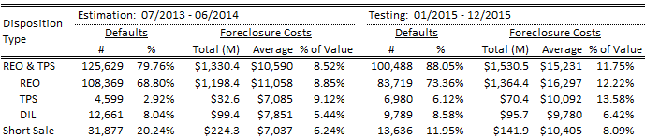
Deep Dive on Components: Foreclosure Cost Factors: Disposition Type
Disposition type has a significant impact on foreclosure costs.
Short sales, which dispose without going completely through foreclosure generally have a lower cost profile than TPS or REO.
Due to this, TPS and REO are grouped separately from short sales in the MI Factor algorithm. TPS volumes are generally fairly low, so we did not include a separate control factor.
Deeds in lieu of foreclosure (DIL), which become REO, are included with TPS and REO for practical implementation reasons.
Descriptive Statistics In vs. Out of Sample: Disposition Method

Slide 15
Deep Dive on Components: Foreclosure Cost Factors: Geography, State Clustering
Differences that vary by geography, such as costs of living, judicial processes, etc., also have a significant impact on foreclosure costs.
To capture these geographical differences, a clustering methodology groups states with similar patterns together, which provides a more streamlined structure for the overall framework.
This has an obvious implementation benefit and also provides the algorithm with greater longevity as default volumes continue to decline.
A k-means cluster algorithm was used to group like states. The k-means algorithm was chosen for two reasons:
1) It allows for an optimized reduction of overall classification factors (8 rather than 50+ here), and
2) It also allows the researcher to remain neutral in the assignment the clusters.

Slide 16
Deep Dive on Components: Foreclosure Cost Factors: Geography, State Clustering
In order to assign the clusters, the k-means cluster algorithm first requires the k, or number of output clusters desired, to be defined.
Several possible groupings were tested, but repeated testing resulted in eight clusters as the optimal recommendation.
With k defined as eight, the algorithm associates the states individually based on fixed and variable costs mean reference points, eight at a time into clusters.
With each iteration, the algorithm attempts to associate the next round of states with prior cluster assignment in an optimization process.
This repeats until convergence has been reached and the end result are eight different clusters of the greatest possible distinction based on fixed and variable costs.
Our proposal would be to allow updated data to dynamically change the groupings of states in cluster assignment, rather than using fixed categories over time.

Slide 17
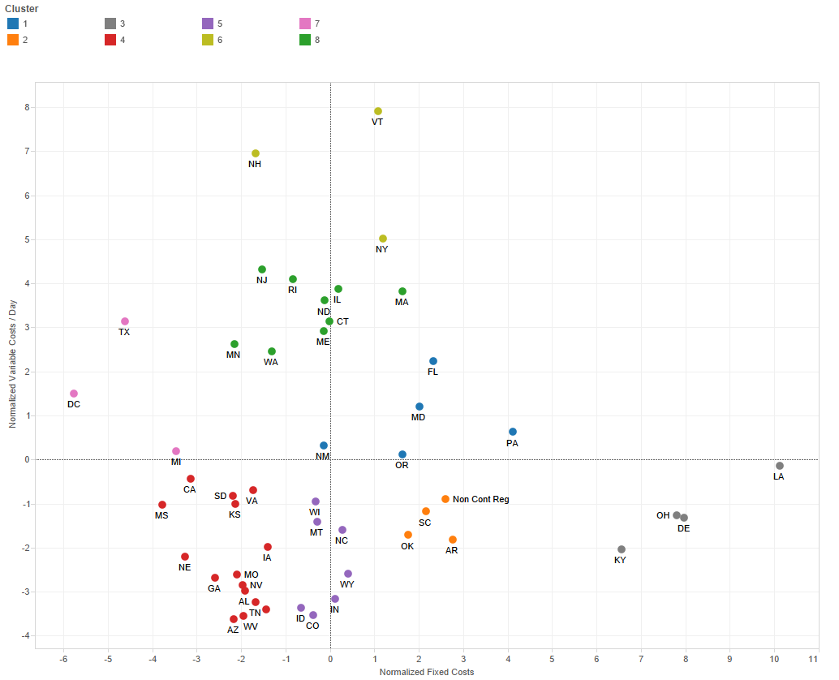
Deep Dive on Components: Foreclosure Cost Factors: Geography, State Clustering Results
The results of the back-test grouping of states for the proof of concept are displayed here.
The closer states are to each other, the more alike their cost profiles are.
Colors on the figure align with the final cluster associations picked by the k-means process.

Slide 18
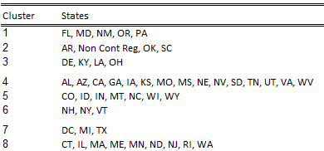
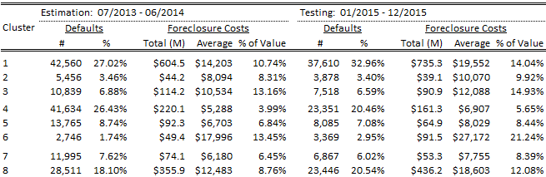
Deep Dive on Components: Foreclosure Cost Factors: Geography, State Clustering Results
Descriptive Statistics In vs. Out of Sample: Geo Groups
Within the top figure, we can see the state assignments at the cluster level.
These groupings may change dynamically as data from different time periods are used to update the framework.
In the figure below, we can see the descriptive statistics of foreclosure costs at the cluster level.

Slide 19
Deep Dive on Components: Foreclosure Cost Factors: Property Value
Many foreclosure costs are influenced by value, the most obvious and largest of which are property taxes.
Since a true sales price is available for short sales, the algorithm uses the short sale price as the value for short sale dispositions.
TPS and REO dispositions use UPB as a value proxy since the sales price is not available at the time of option .
The property value buckets were specified through the use of means and +/- 1 standard deviation by disposition channel.
Descriptive Statistics In vs. Out of Sample: Property Value/UPB

Slide 20
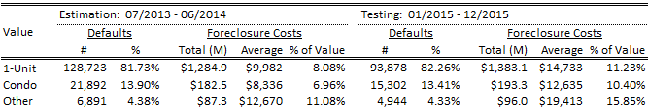
Deep Dive on Components: Foreclosure Cost Factors: Property Type
Maintenance requirements, which impact the overall foreclosure costs, vary by property type.
The proposed property type specification is grouped into three buckets. Eighty five percent of all defaults are single-family properties, which make up the first bucket.
Condos make-up the second bucket since their multifamily-like structure has different maintenance requirements than do other single family properties.
The third bucket is made up of all the other property types, including two to four unit properties as well as manufactured housing.
Descriptive Statistics In vs. Out of Sample: Property Type

Slide 21
Deep Dive on Components: Allowable Delays and Impact on Self-Curtailment
There are events that cause a loan’s actual foreclosure timeline to reasonably extend beyond the published guidance.
Fannie Mae refers to these as ‘allowable delays’. Allowable delays are applied as extra days above the fixed foreclosure timeline schedule when evaluating servicer performance. This would result in lower curtailments on those cases where they are present.
Types of allowable delays that Fannie Mae credits to lenders are:
Various forms of bankruptcy (Chapter 7, 11, 12, and 13)
Probate or other contested litigation related credits
Certain types of workout credits for modifications/trials
Military allowances.
Fannie Mae can account for each of these based on common servicer submissions at a loan level and will convey any information related to these events to MI companies at the point of claim.
Servicers often provide further information during a case-level rebuttal process for compensatory fees. Fannie Mae is not considering to include these rebuttals in MI claim processing, given manual nature.

Slide 22
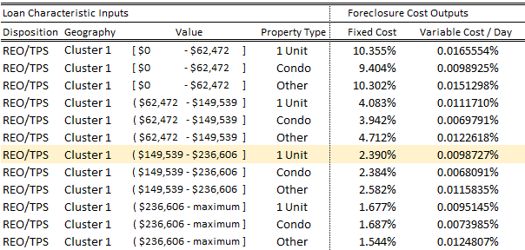
Example Application of Proposal to a Single Claim
Grid Implementation Example
As foreclosure costs are a function of the loan characteristics, the proposed grid implementation uses the loan characteristics as the inputs and has fixed and variable costs as the outputs. The following provides an example of how to use the grid to solve for fixed and variable foreclosure costs.
For example, a borrower defaults on a mortgage with the following loan characteristics.
Disposition Type: REO
Geography: Cluster 1
Property Value (UPB): $150,000
Property Type: 1-Unit

Slide 23
Example Application of Proposal to a Single Claim
Using the loan characteristics to look up the fixed and variable cost percentages in the grid, the fixed and variable cost amounts can be calculated as follows.
Fixed Cost Amount = Fixed Cost Percent from Grid * Property Value
Variable Costs per Day = Variable Cost Percent from Grid * Property Value
Fixed Cost Amount = 2.390% * $150,000 = $3,585
Variable Cost Per Day = 0.0098727% * $150,000 = $14.81

Slide 24
Example Application of Proposal to a Single Claim
MI Factor Calculation & Example
Once the grid values have been used to calculate the fixed and variable cost amounts, MI Factor can be calculated. Continuing the example, the defaulted mortgage also has the following loan characteristics.
LPI Date: January 1, 2015
Liquidation Date: September 30, 2015
Allowable Days: 240
MI Factor is calculated as follows.
Actual Days= Liquidation Date – LPI Date
MI Factor = Fixed Costs + (Variable Costs per Day * minimum (Actual Days, Allowable Days))
Actual Days= September 30, 2015 – January 1, 2015 = 272 Days
MI Factor = $3,585 + ($14.81 * minimum (272, 240)) = $7,139.17

Slide 25
Example Application of Proposal to a Single Claim
MI Claim Amount Calculation & Example
MI claim amount is the sum of the UPB, interest, and the foreclosure cost. The proposed changes to the interest and the foreclosure cost components are covered below. There are no changes proposed for the UPB component of the MI claim amount calculation.
Note Rate = 5%
Curtailed Interest = UPB * (Note Rate / 365) * minimum (Actual Days, Allowable Days)
Curtailed Interest = $150,000 * (5% / 365) * minimum (272, 240) = $4,931.51
Foreclosure Costs = MI Factor = $7,139.17
MI Claim Amount = UPB + Curtailed Interest + MI Factor
MI Claim Amount = $150,000 + $4,931.51 + $7,139.17 = $162,070.68

Slide 26
Example Application of Proposal to a Single Claim
MI Claim Settlement Example: Option Settlements
This example only covers the proposal for option settlements since presales with influence and MI acquisitions are still being researched. Assuming that our example loan has an MI coverage percent of 20%, option settlements are calculated as follows.
MI Claim Payment = MI Claim Amount * MI Coverage Percent
MI Claim Payment = $162,070.68 * 20% = $32,414.14

Slide 27
Summary of Follow-up Materials
White Paper
Detailed breakdown of MI factor algorithm research.
Companion Doc: Explanation of POC files
Input Dataset
Filename: MI_Factor_Sample.csv
Contains the data used to derive the recommended algorithm.
SAS Code
Filename: MI_Factor_Algorithm.sas
An executable SAS code that generates the results of each algorithm option.
Cluster Statistics
Filename: State_Cluster_Stats.pdf
Statistics on the k-means state clustering.
Grid Matrices
Filename: MI_Factor_Grid_Matrix_Option[#].csv
An example of the grid that would be outputted for each algorithm option.
Output Datasets
Filename: MI_Factor_Option[#].csv
All the fields generated by the SAS code post ingestion of the input dataset.

